Slide 1
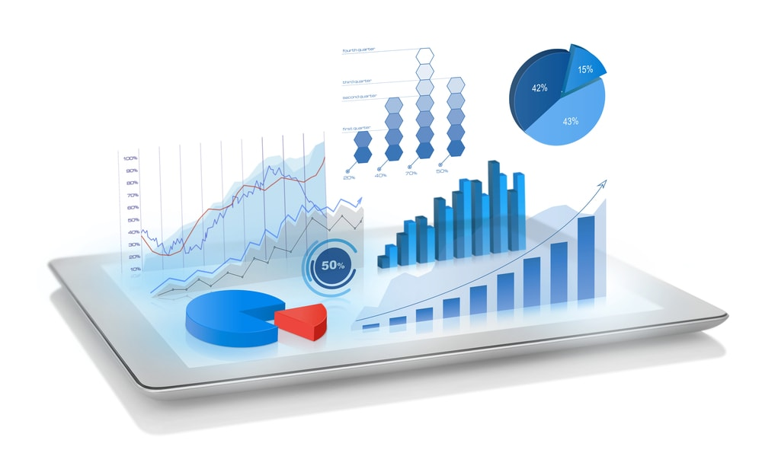
Demo: Cloud, Data Visualization and Analytics for IoT

Slide 2
Topic
Introduction of Cloud
Topic 1
Topic 2
Introduction of Data Visualization
Topic 3
Analytics based on IoT

Slide 3
Cloud
The term Cloud refers to a Network or Internet
In other words, we can say that Cloud is something, which is present at remote location.
Cloud can provide services over network, i.e., on public networks or on private networks, i.e., WAN, LAN or VPN.
Applications such as e-mail, web conferencing, customer relationship management (CRM), all run in cloud

Slide 4
What is Cloud Computing
Cloud Computing is the use of hardware and software component to deliver a service to a network.
User can access these files and applications from any device that can access internet
Cloud Computing service providers give the ability to manage and services through a global network
Example: Amazon Web Service Microsoft Azure DigitalOcean

Slide 5





Benefits
Speed
Vast amount of computing resource can be provided in minutes
Accessibility
Easy to access data anywhere
Cost
It eliminate the expense of buying hardware and software
Better Security
With cloud data is stored in a secure location
Scalability
Easy to scale up cloud capacity

Slide 6
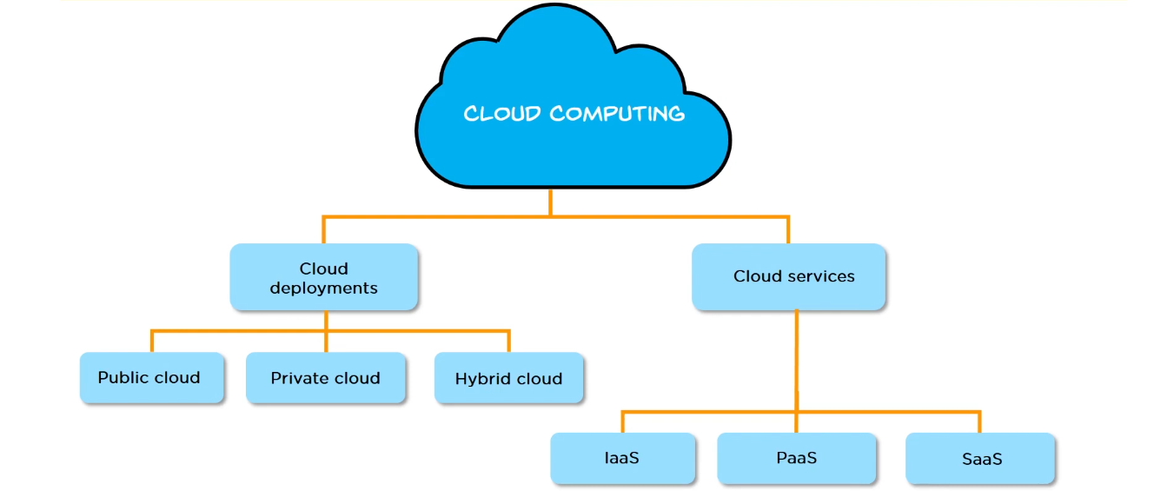
Type of Cloud Computing

Slide 7
Deployment model – Cloud Computing
Public Cloud
Here the services are stored off-site and accessed over the internet
It can be used by each public
All hardware software and supporting infrastructure is owned and manages by the cloud provider
Example: Amazon Web Services and Microsoft Azure
Private Cloud
Hybrid Cloud

Slide 8
Deployment model – Cloud Computing
Public Cloud
The cloud infrastructure is used exclusively by a single organization
The organization may run its private cloud or outsource it to a hosting company
The services and infrastructure are maintained on a private network
Private Cloud
Hybrid Cloud

Slide 9
Deployment model – Cloud Computing
Public Cloud
It consist the functionalities of both public and private cloud
In the Hybrid cloud, non-critical activities are performed by the public cloud and critical activities are performed by the private cloud.
Mainly, a hybrid cloud is used in finance, healthcare, and Universities
Private Cloud
Hybrid Cloud

Slide 10
Service Model – Cloud Computing
Infrastructure as a Service (IaaS)
Cloud infrastructure services, known as Infrastructure as a Service (IaaS), are made of highly scalable and automated compute resources
It can modify as per the demand and the customer has to pay only for what they have used
IaaS can scale up and down as per the demand so the customer doesn’t pay any extra charges
An IaaS cloud provider give a variety of computing infrastructure such as storages, servers, networking hardware
It also maintain and supports these infrastructure
Platform as a Service (PaaS)
Software as a Service (SaaS)

Slide 11
Service Model – Cloud Computing
Infrastructure as a Service (IaaS)
Platform as a Service (PaaS) provides a runtime environment.
PaaS (Platform as a Service), as the name suggests, provides you computing platforms which typically includes operating system, programming language execution environment, database, web server etc.
PaaS enables to deliver from simple cloud-based applications to higher cloud-enabled applications
It allows programmers to easily create, test, run, and deploy web applications
Platform as a Service (PaaS)
Software as a Service (SaaS)

Slide 12
Service Model – Cloud Computing
Infrastructure as a Service (IaaS)
Software as a service (or SaaS) is a way of delivering applications over the Internet—as a service
Software-as-a-Service (SaaS) is a software licensing model in which access to the software is provided on a subscription basis
Software-as-a-Service is typically accessed through a web browser, with users logging into the system using a username and password.
Instead of each user having to install the software on their computer, the user is able to access the program via the Internet.
Platform as a Service (PaaS)
Software as a Service (SaaS)

Slide 13
Data Visualization
What is data visualization ?
Data visualization is the graphical representation of information and data. By using visual elements like charts, graphs, and maps.
The main goal of data visualization is to make it easier to identify patterns, trends and outliers in large data sets
The goal of data visualization is to communicate data or information clearly and effectively to readers.

Slide 14
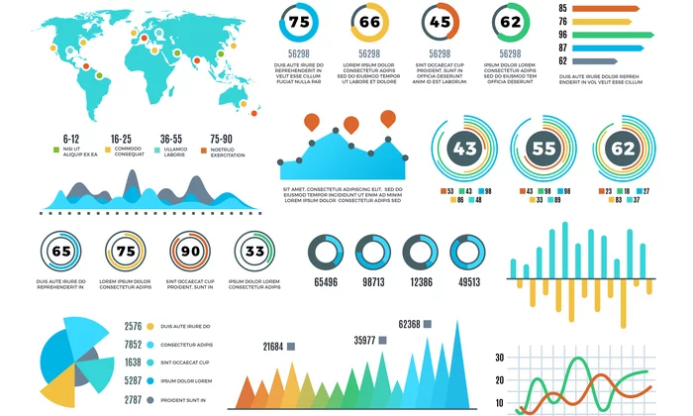

Slide 15






Data visualization can be used for
Highlighting the important parts of a set of data
Can share our story with others
Telling a story found within the data
Identifying trends and outliers within a set of data
Making data engaging and easily digestible

Slide 16
Advantages of data visualization
Quick, clear understanding of the information
Identify emerging trends and act quickly based on what we see
Identify relationships and patterns within digital assets
Can share our story with others
Analysis at various levels of detail

Slide 17
IoT Data Analytics
What is IoT Data Analytics
IoT analytics is the application of data analysis tools and procedures to realize value from the huge volumes of data generated by connected Internet of Things devices.

Slide 18
Why Use IoT Analytics
IoT analytics tools help us to successfully leverage complex IoT datasets
We can derive a number of benefits from it
Present data in a digestible and meaningful
Insight provided by the data analysis

Slide 19
IoT Analytics Strategy
Leverage automation
Centralize data
Match analysis components
Enforce security

Slide 20
Benefits of IoT analytics
Increased visibility and control, leading to faster decision making
Scalability and growth in new markets
Reduced operational costs through automation and smarter utilization of resources
Creation of new revenue streams through the resolution of problems and challenges
More accurate attribution of problems, leading to better solutions – faster
Faster problem solving and prevention of recurring problems

Slide 21
Thank You

